Slide 1
Safe and Legal routes to the UK
Emma Harrison
Strategy Director, Reset

Slide 2
About us
Formed in 2018 to grow the Community Sponsorship movement in the UK.
So far, we’ve supported more than 300 community groups to welcome over 800 refugees.
Deliver a matching service as part of Homes for Ukraine
Piloted a scheme to bring refugee nurses to the UK
Funded by the Home Office, DLUHC and philanthropy

Slide 3
Global context
103 MILLION forcibly displaced people worldwide
Just three countries--Turkey, Colombia and Pakistan--host a quarter of the world’s refugees
UK takes considerably less than 1% of the worlds refugee population
Asylum in the UK
Albania was the top nationality claiming asylum in the UK in the year ending September 2022 with 13,650 asylum claims. Iran is now second, after being the first every year since 2016.
The top five countries of nationality for asylum applications were: Albania (13,650), Iran (9,652), Afghanistan (6,644) Iraq (6,333) and Syria (4,143).

Slide 4
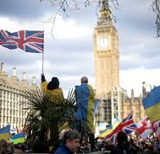
Current safe routes
Homes for Ukraine
Hong Kong British Nationals (Overseas) Visa
Afghan Relocations and Assistance Policy
Afghan Citizens Resettlement Scheme
United Kingdom Resettlement Scheme
Mandate Resettlement Scheme
Community Sponsorship
Displaced Talent Visa Scheme

Slide 5
Homes for Ukraine
Open to all displaced Ukrainians who either have family in the UK or have found a UK host
Ukrainians will be given a three-year visa, can work and access public funds
Hosts subject to local authority & police checks
Hosts offered £350 for up to 12 months to host

Slide 6
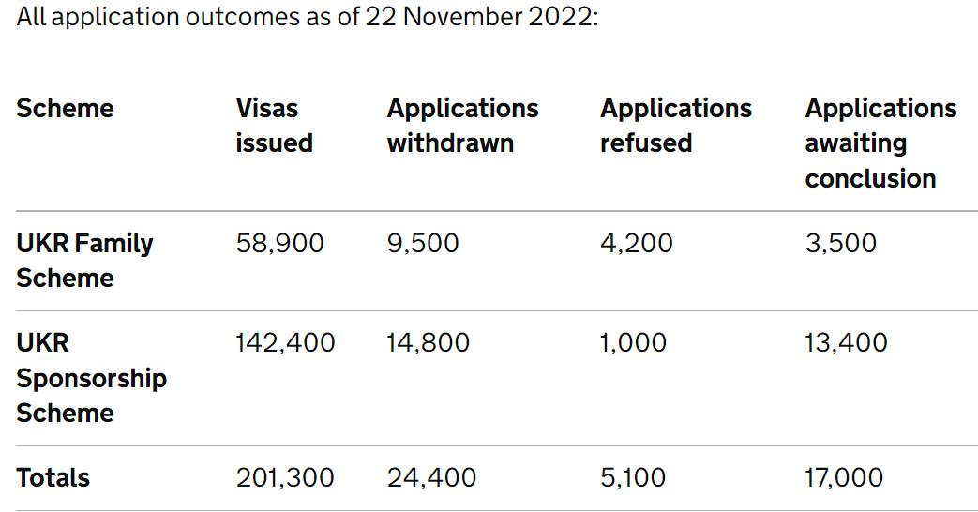
Homes for Ukraine
Notes:
– do you want to come across as reassuring and authoritative? Or friendly and helpful?

Slide 7
Hong Kong British National (Overseas) Visa
Launched January 2021 to allow British National (overseas) status holders, and their dependents to come to the UK
Application in Hong Kong for 2 years 6 months or 5-year visa
Can work / study
Access some benefits (dependent on circumstance)
Able to apply to stay permanently after 5 years
140,500 applications for the BN(O) route since its introduction on 31st January 2021 up to the end of June 2022.

Slide 8
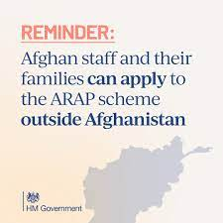
The Afghan Relocations and Assistance Policy
Date | Arrivals | Notes
Before Operation PITTING | Around 2,000 | All being relocated under ARAP
During Operation PITTING | Around 15,000 | Some evacuees are British Nationals, who do not require a grant of leave, to stay in the UK
After Operation PITTING | Around 6,000 | ARAP and ACRS Pathway 1 only.
For Afghan citizens who worked for or with the UK Government in Afghanistan in exposed or meaningful roles and may include an offer of relocation to the UK for those deemed eligible by the Ministry of Defence, and who are deemed suitable for relocation by the Home Office.

Slide 9
The Afghan Citizens Resettlement Scheme (ACRS)
ACRS provides a safe and legal way for some of the most vulnerable and at-risk people – including women, children, LGBTQ people - from Afghanistan to come to the United Kingdom and rebuild their lives.
The Government has committed to welcoming up to 20,000 people who are at risk through the ACRS over the next few years.
Although only four people have been brought to the UK to date through ACRS 2 https://www.bbc.co.uk/news/uk-politics-63743620

Slide 10
ACRS in detail
Pathway 1: vulnerable and at-risk individuals who arrived in the UK under the evacuation programme were the first to be settled under the ACRS.
2. Pathway 2: referrals from the United Nations High Commissioner for Refugees (UNHCR) of vulnerable refugees who have fled Afghanistan for resettlement to the UK.
3. Pathway 3: a route to resettlement for those at risk who supported the UK and international community effort in Afghanistan. There are 1,500 places available in the first year under Pathway 3.

Slide 11
United Kingdom Resettlement Scheme (UKRS)
Announced in June 2019 and launched in February 2021 UKRS consolidated the following schemes:
Vulnerable Persons Resettlement Scheme
Vulnerable Children Resettlement Scheme
Gateway Protection Programme
UNHCR refers refugees to the UK for resettlement:
Most vulnerable refugees
No chance of retuning to their home nation
Have official refugee status
1,101 refugees have been resettled through the UK Resettlement scheme (Sept 21-22)

Slide 12
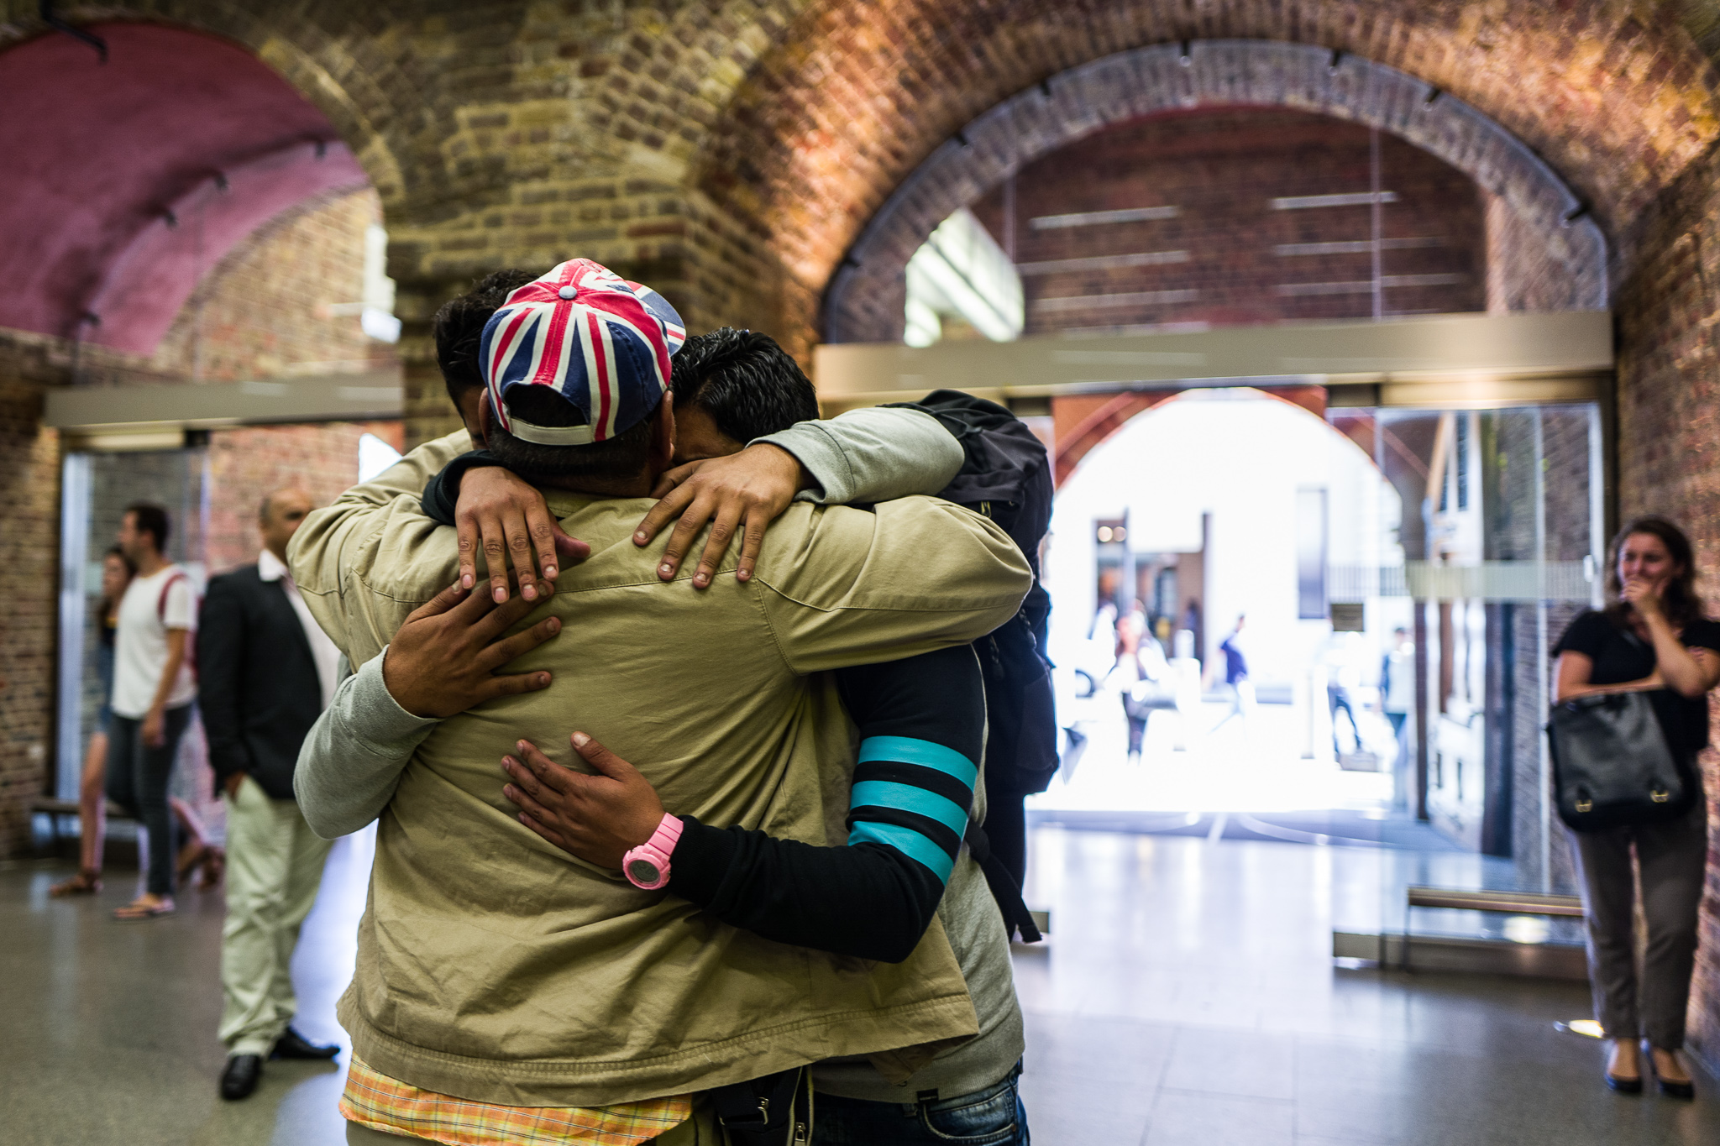
Mandate Resettlement Scheme
The Mandate Resettlement Scheme is a global scheme and resettles recognised refugees with a close family member in the UK who is willing to accommodate them
The refugee must be a minor child, spouse, or parent or grandparent aged over 65 of someone settled in the UK
Very little awareness of this scheme
Six people have been issued a visa under this scheme in the last 12 months

Slide 13
Community sponsorship
Companion scheme to UKRS
Community-led welcome based on group forming and working together to bring a refugee family to the UK
Community applies to local authority and Home Office to welcome family
Refugee family are provided with access
300 groups have welcomes 852 refugees since the scheme launched
284 people have arrived since January 2022

Slide 14
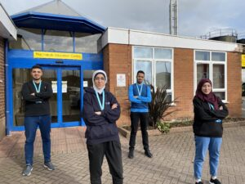
Displaced Talent Mobility Visa
Displaced people need a job offer from a licensed sponsor
Minimum salary level & English language requirements must be met
The visa will last for five years and can lead to settlement
It is possible to change employers once in the UK
Eligible family members will be able to come too
Looking to bring 750 skilled refugees to the UK over five years

Slide 15
Conclusions
Complex picture – even experts are confused!
Most routes are very specific with few people eligible to apply
Genuine refugees have very few pathways to access safety
Planned, organised routes to safety provide comfort for communities
We can capture the learning and harness community desire to support refugees

Slide 16
Safe and Legal routes to the UK
Emma Harrison
Strategy Director, Reset
Notes:
Sorry that this will be

